Slide 1
GOA Calculator
By: Asad Mirza
CV-PEUTICS

Slide 2
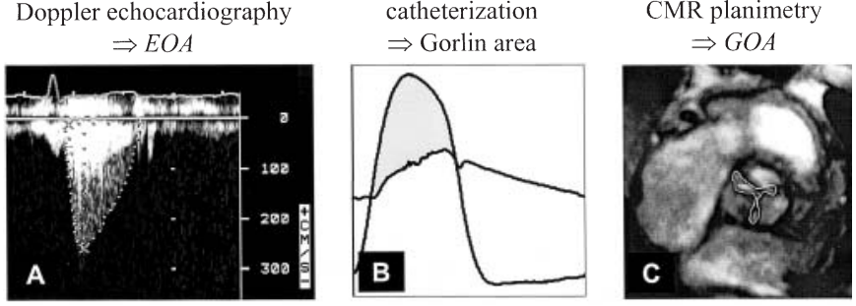
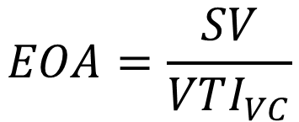
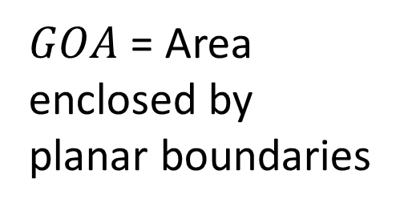
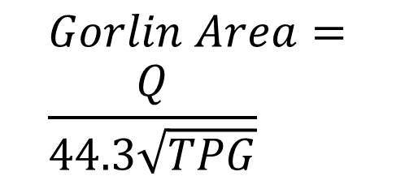
What is GOA?
$$Gorlin Area= \\ \frac{Q}{44.3\sqrt{TPG}}$$
$GOA$ = Area enclosed by planar boundaries
$$EOA=\frac{SV}{VTI_{VC}}$$

Slide 3
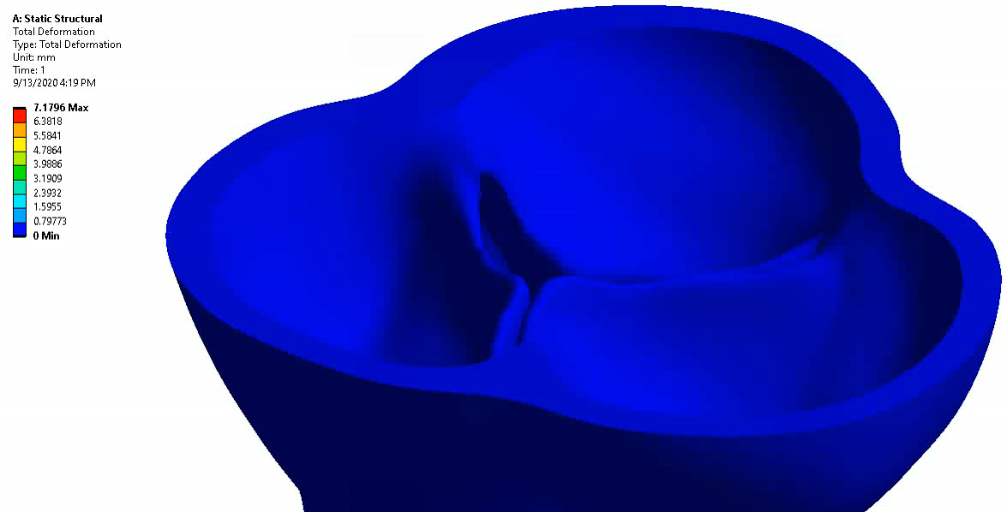
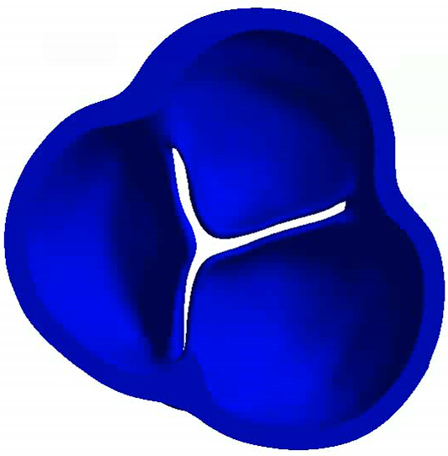
ANSYS Structural Simulation
Material properties – Mooney Rivilin (2nd order)
Boundary Condition:
Radial Displacement: 6 mm
Frictionless Support on top/bottom of inlet/outlet.
High element quality mesh and convergence of 1x10⁻⁶ set for all equations.

Slide 4
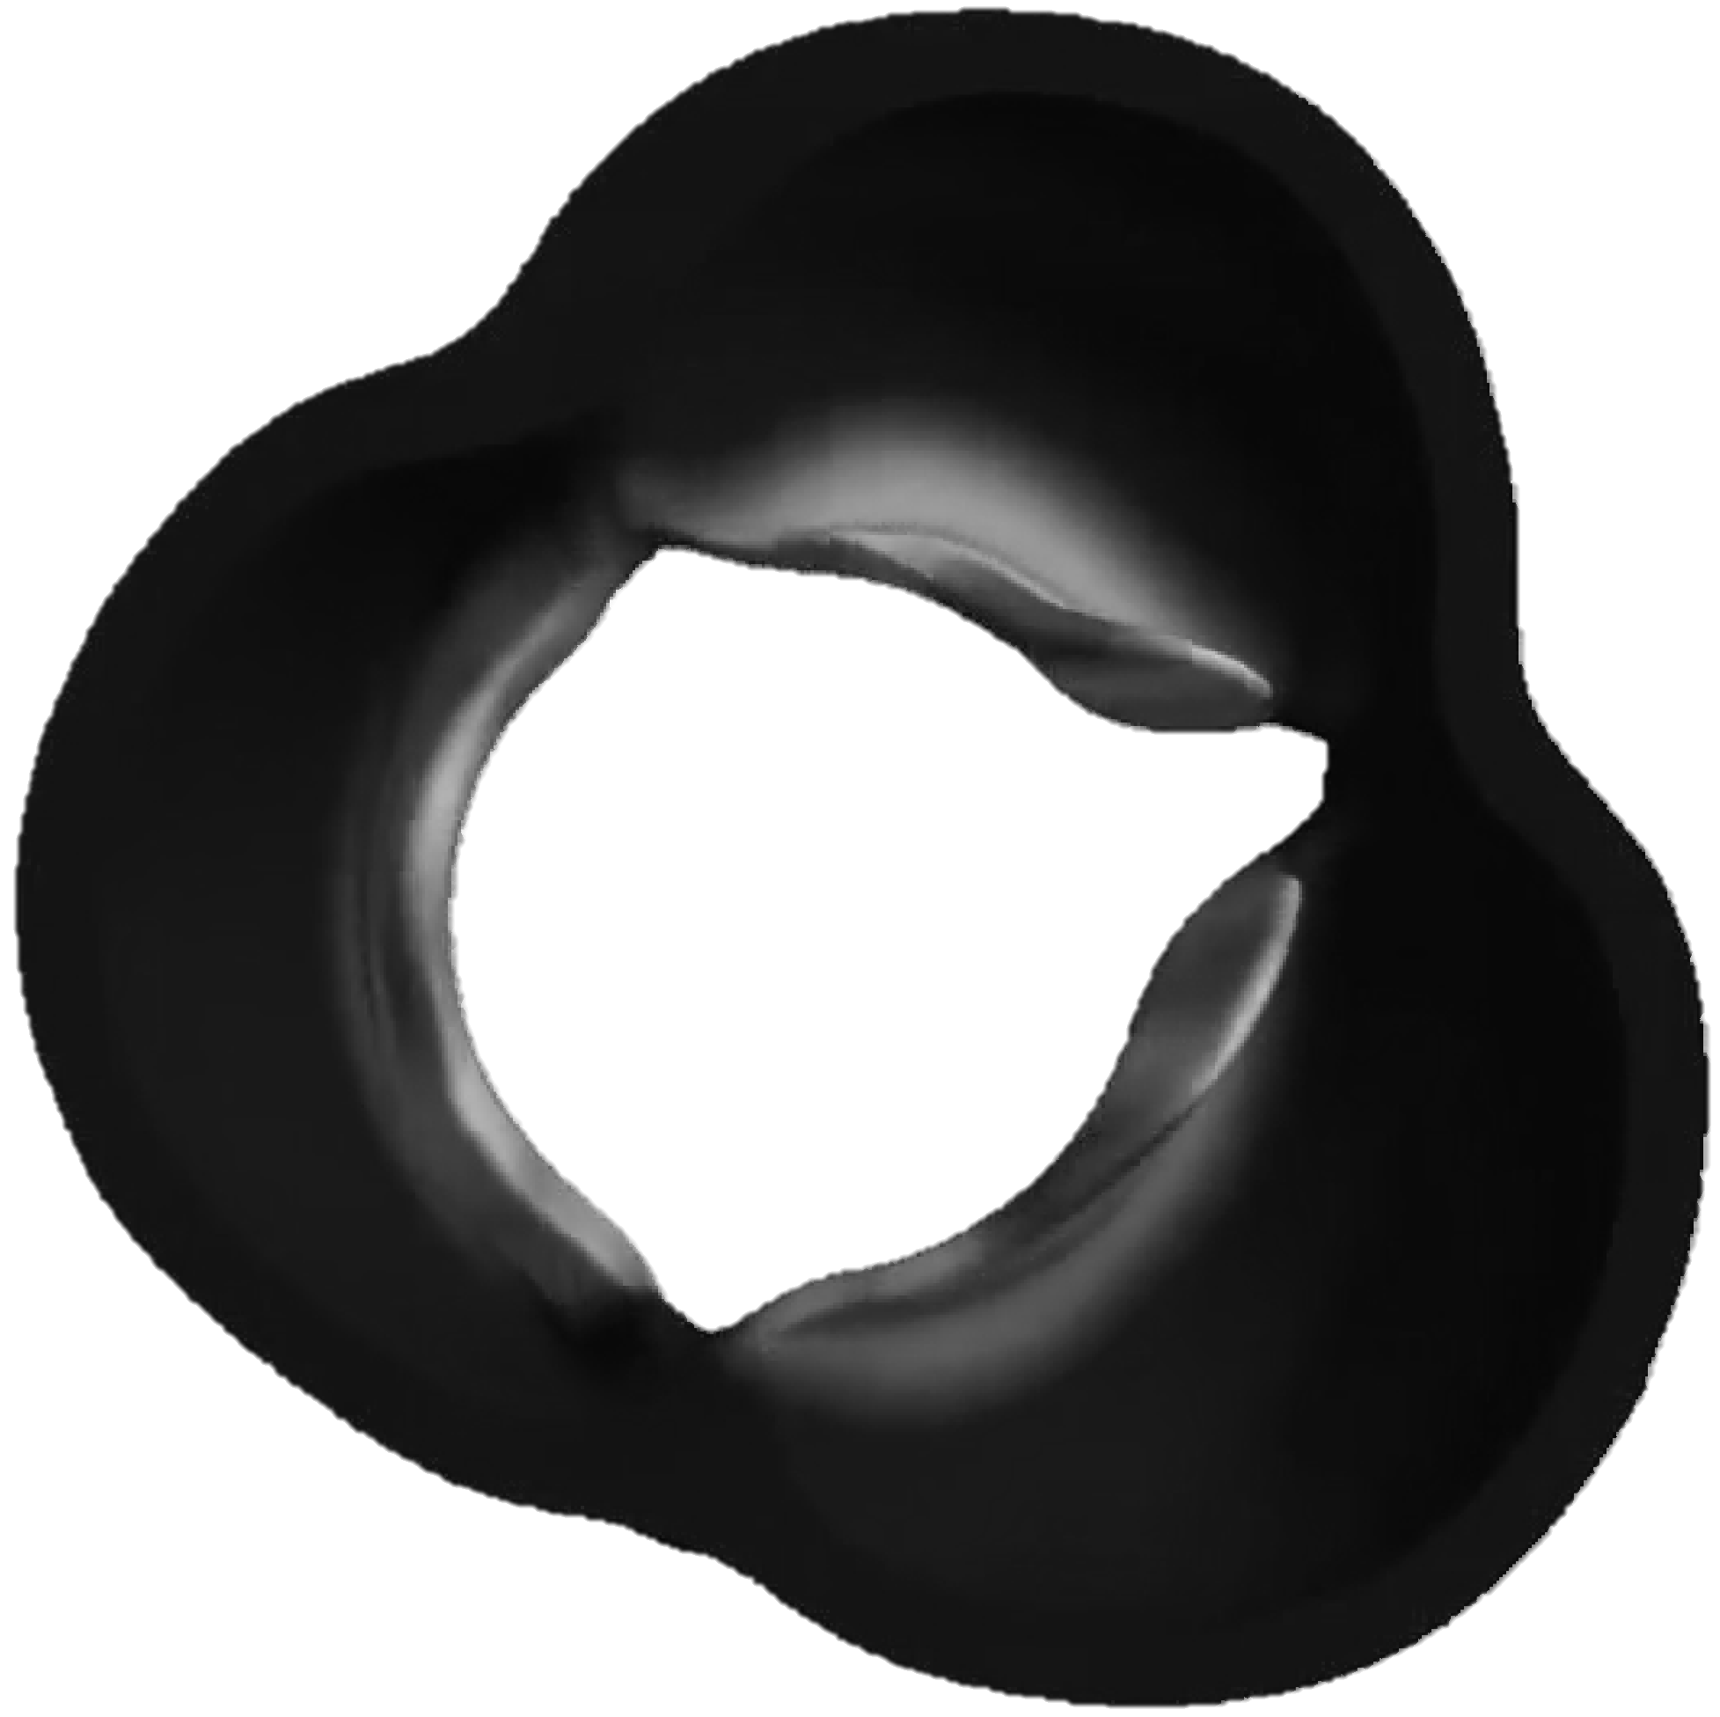
Grayscale
Signal to noise: Color information not important for finding edges of GOA area.
Complexity of code / Speed: Color is a MxNx3 matrix while grayscale is just MxN.

Slide 5
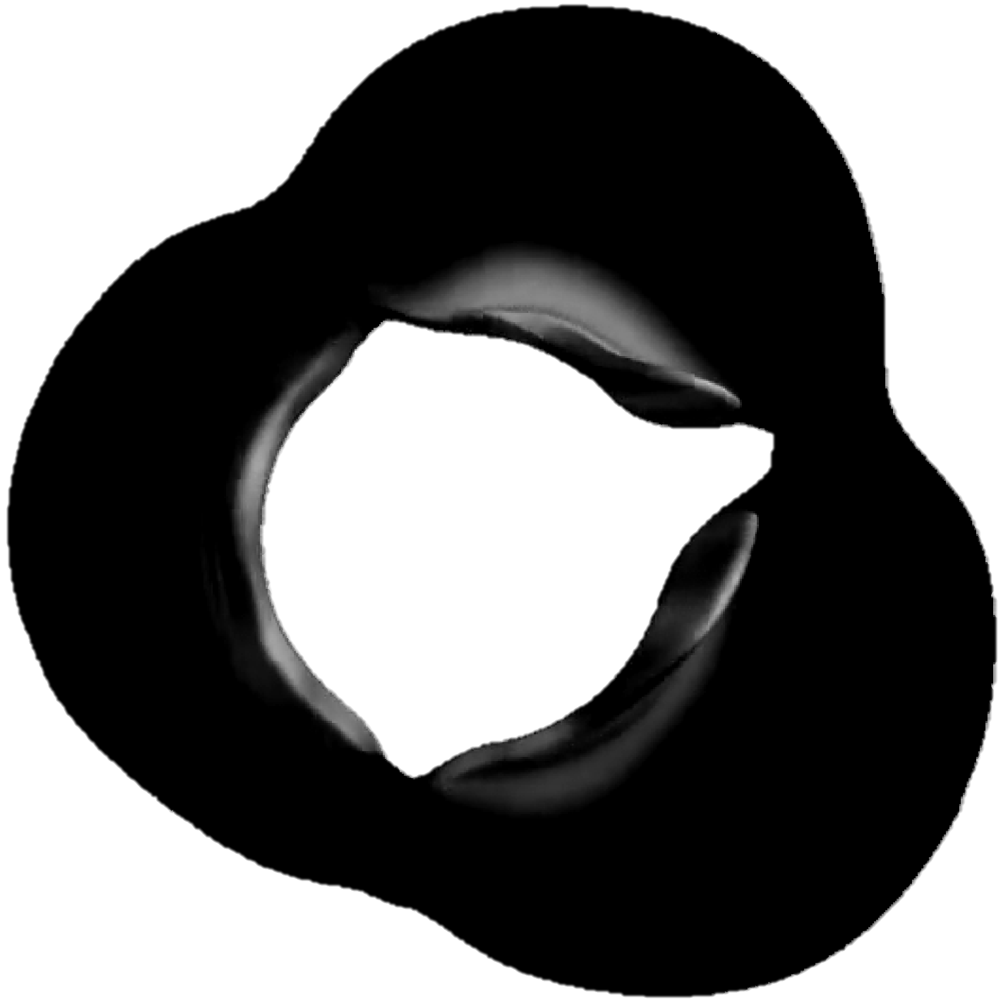
Image Contrasting
Map intensity of values from default range to constrained range.

Slide 6
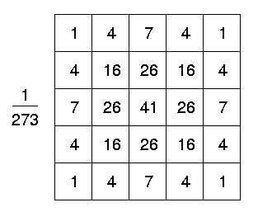
Gaussian Blur
Blur center and surrounding pixels, emphasizes edges.

Slide 7
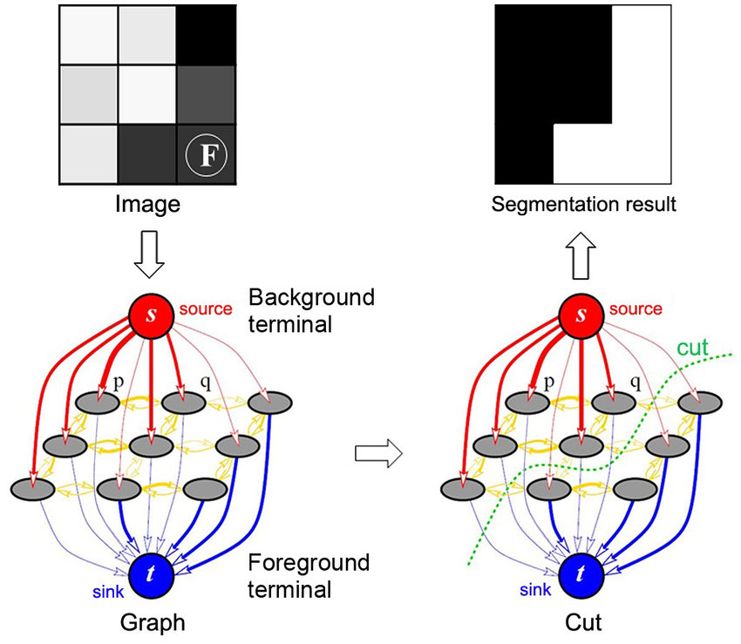
Graph Cut
Pixels are nodes
Valve/Not Valve = Source/Sink
Add cost to each node
Find most efficient cut

Slide 8
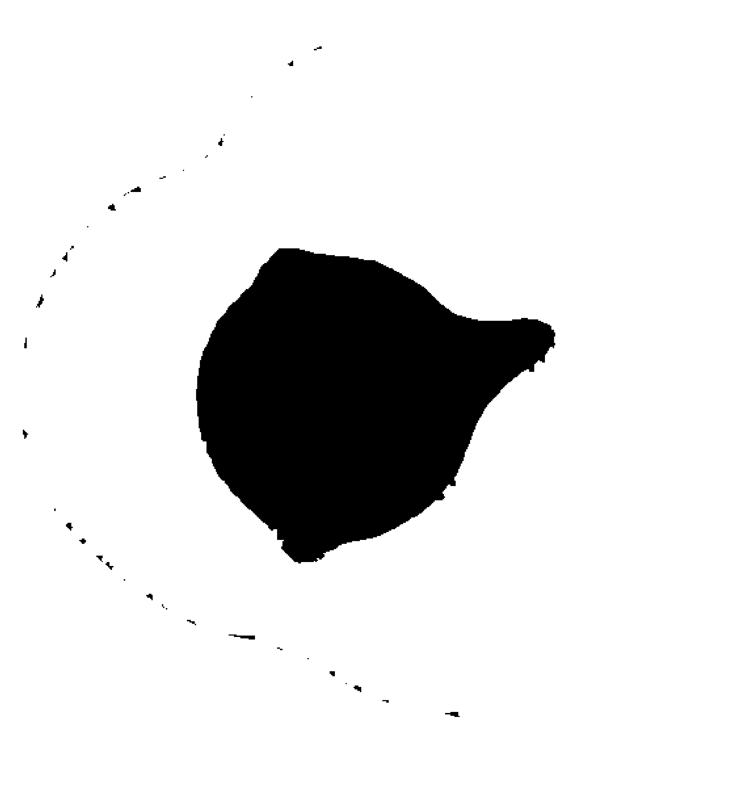
Flood Fill
Select starting point in background.
Algorithm fills in region up to boundaries of foreground.

Slide 9

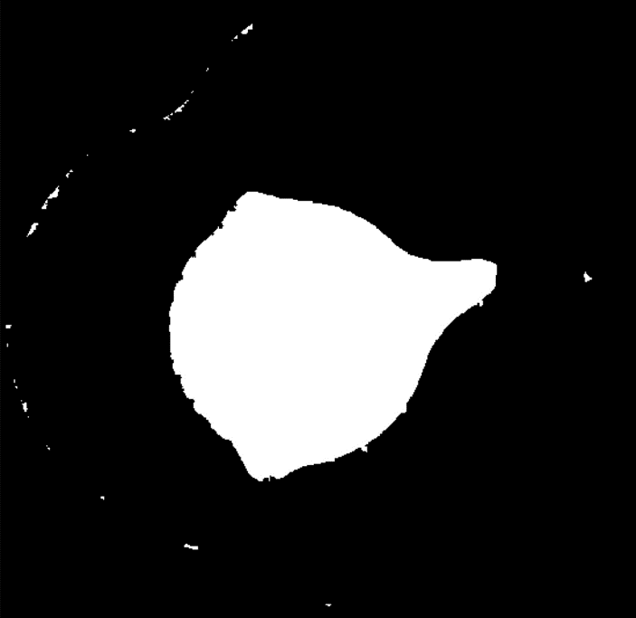
Active Contour
Fills in regions smaller than specified size.
Results in only largest region remaining.

Slide 10
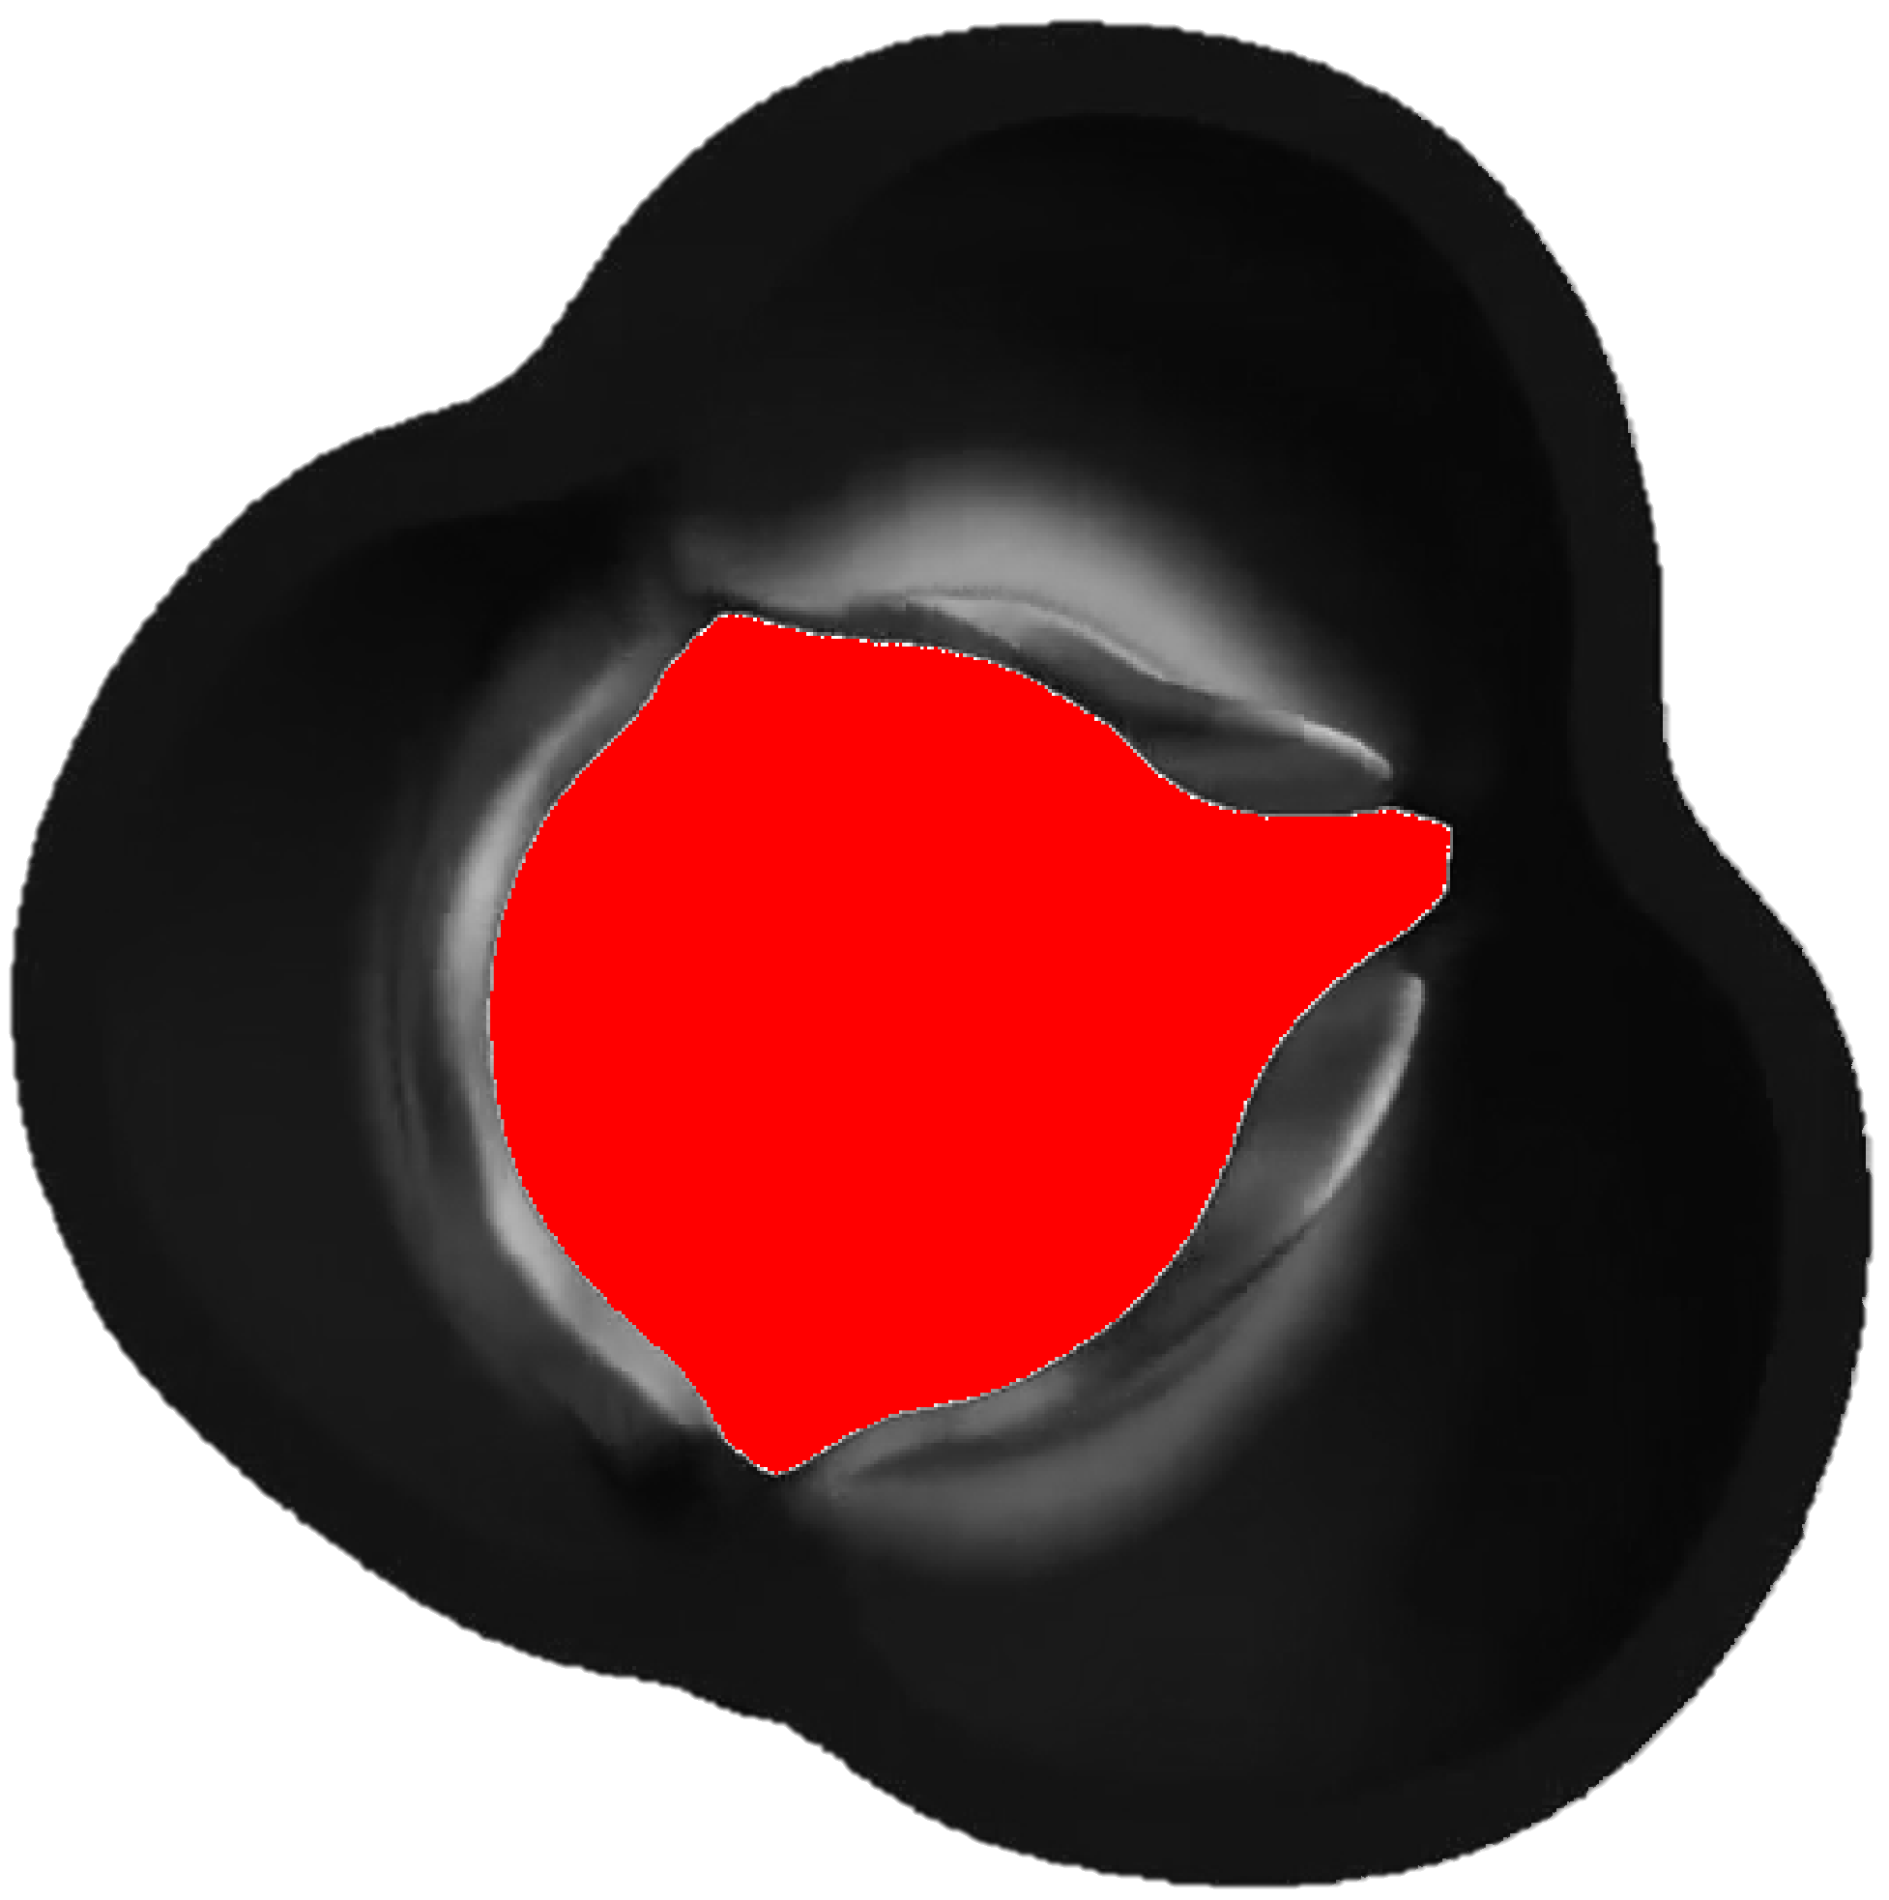
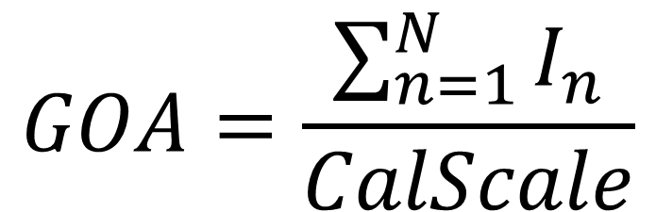
Area Extraction
Summation of total number of pixels (n) in image (I) that are white.
Convert from pixel area to cm² using calibration scale.
GOA = 0.8 cm²
$$GOA=\frac{\sum_{n=1}^{N}{I_{n}}}{CalScale}$$

Slide 11


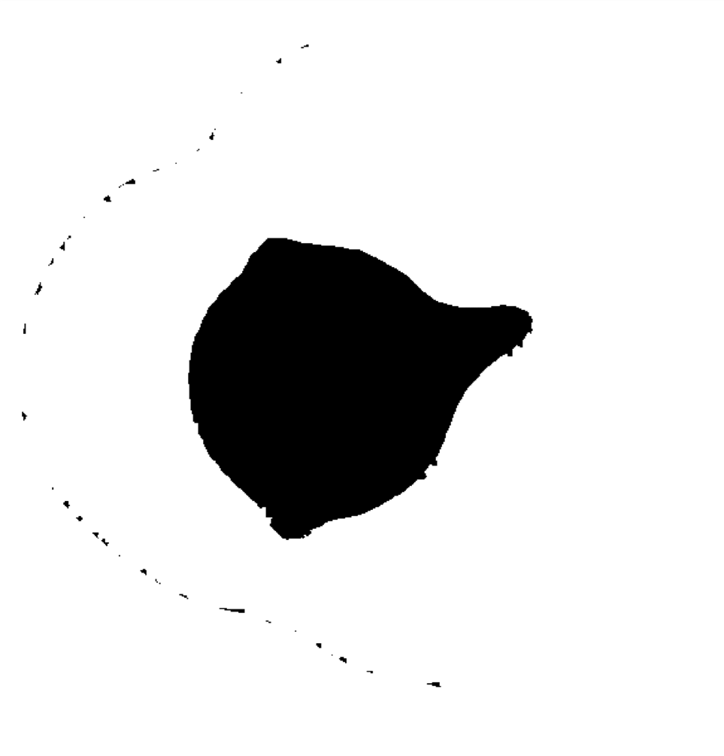
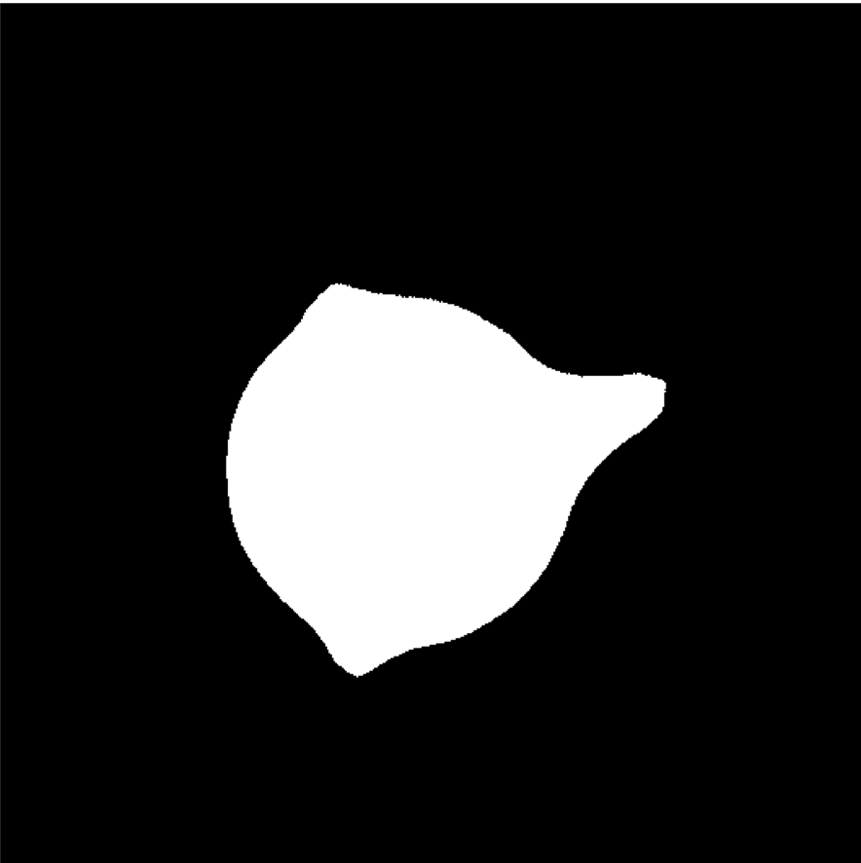
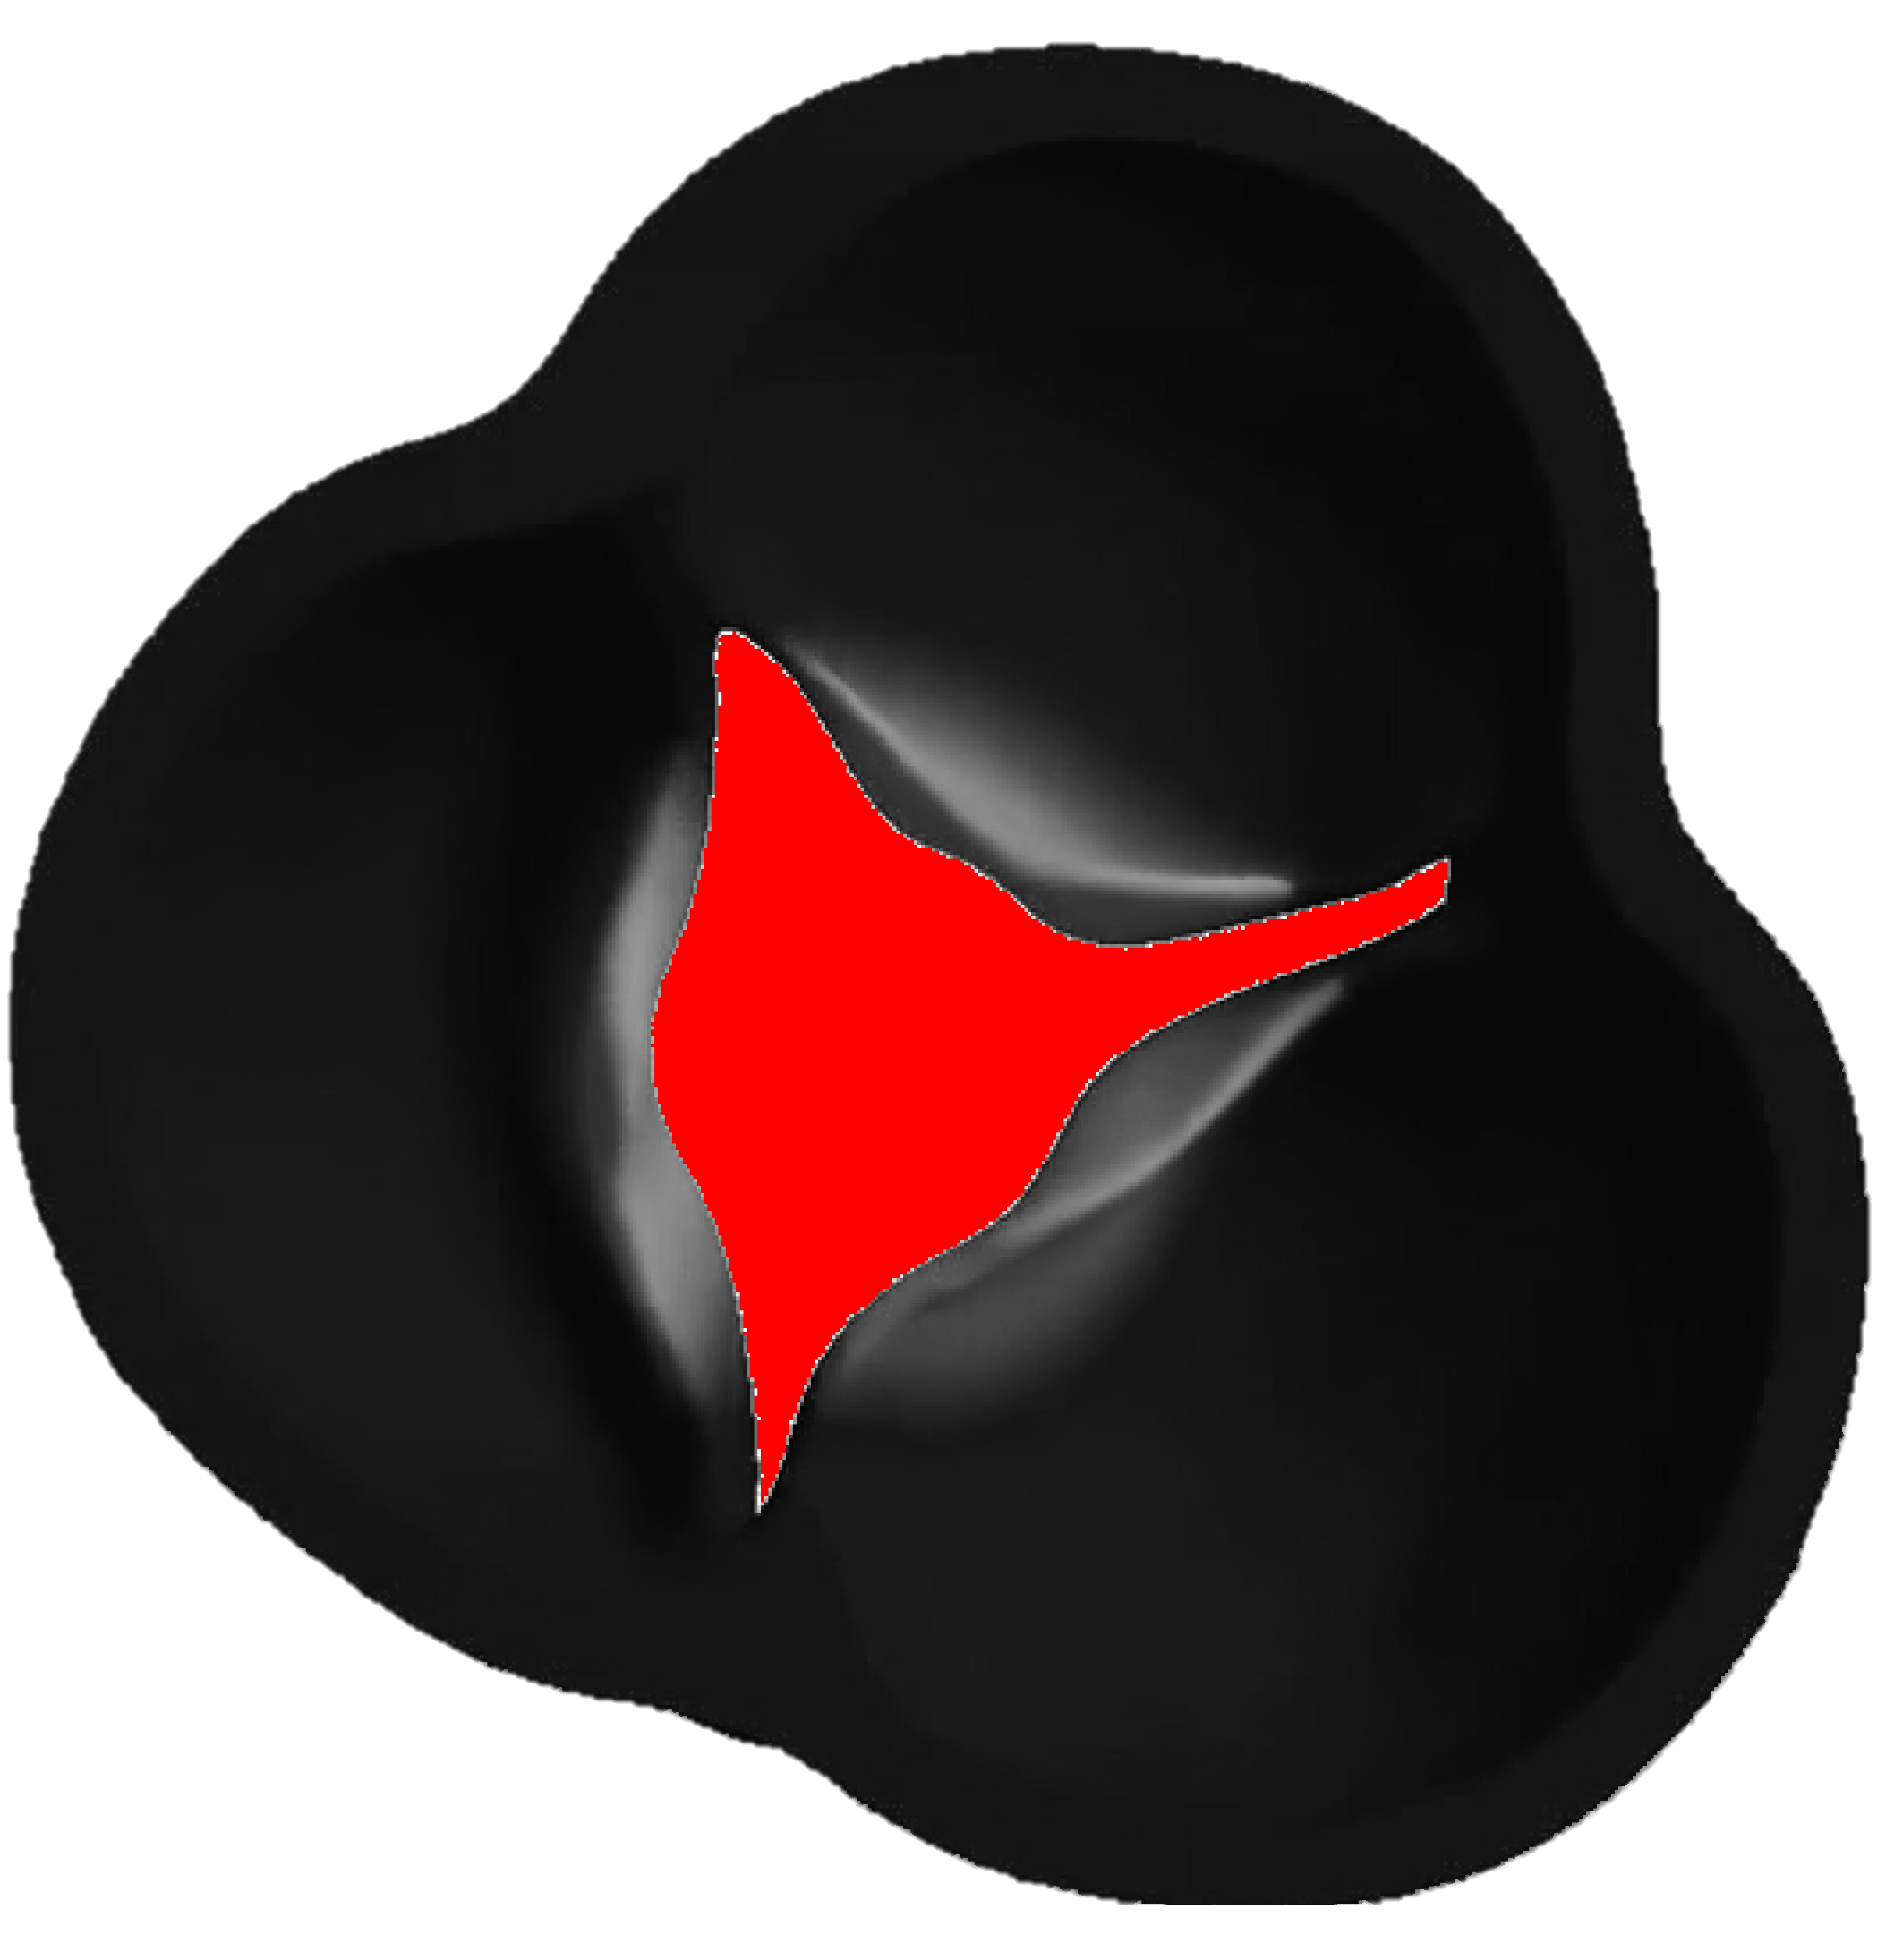
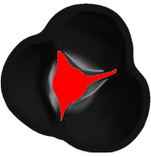
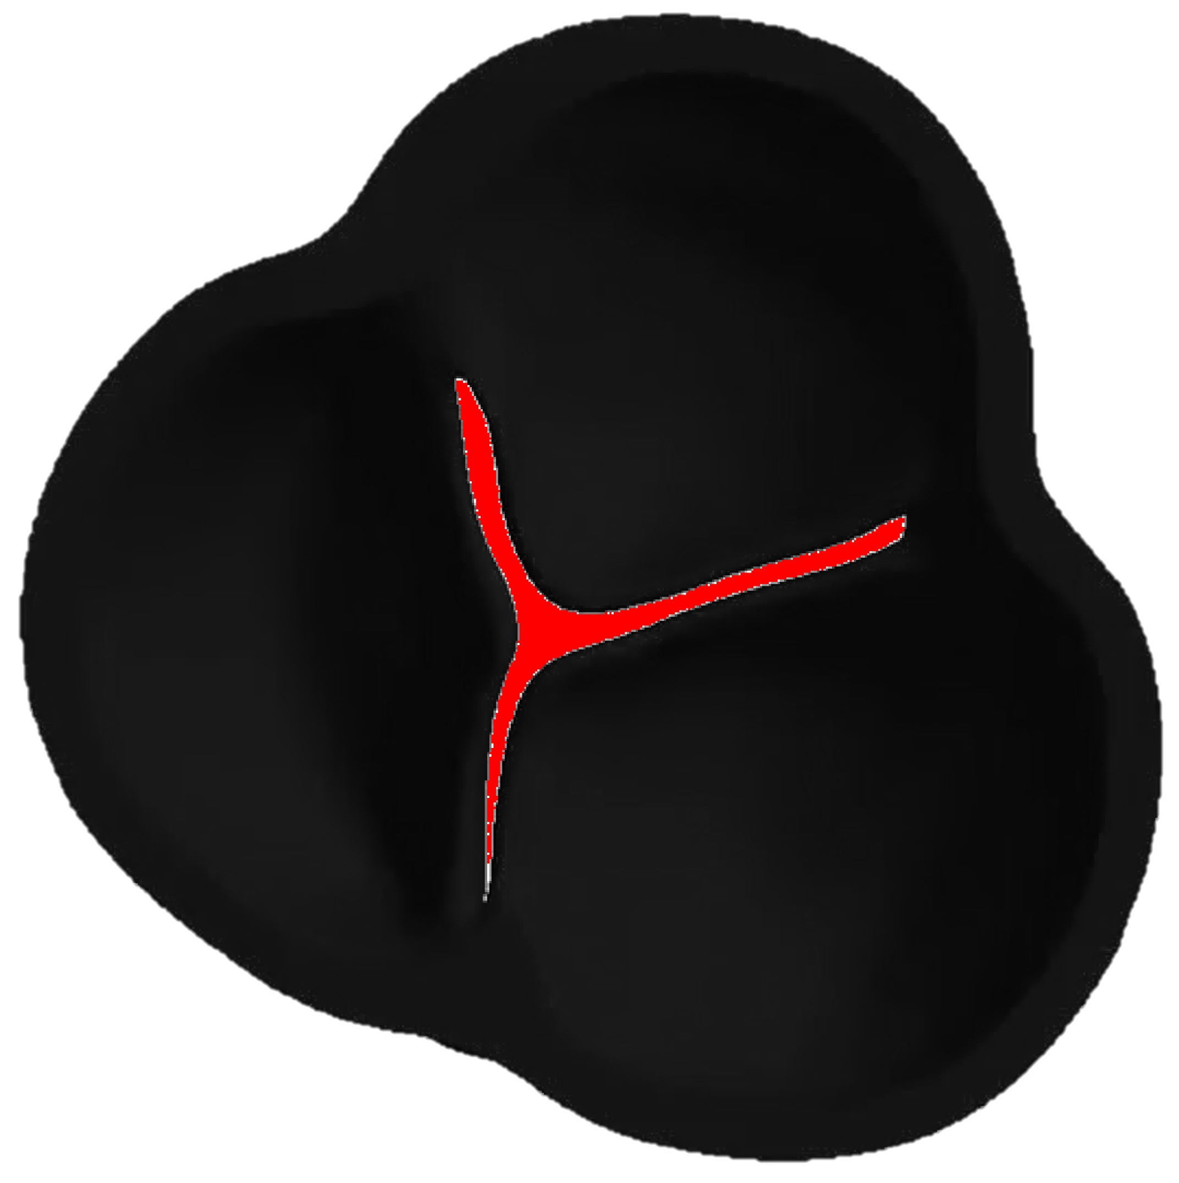
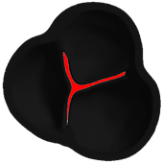
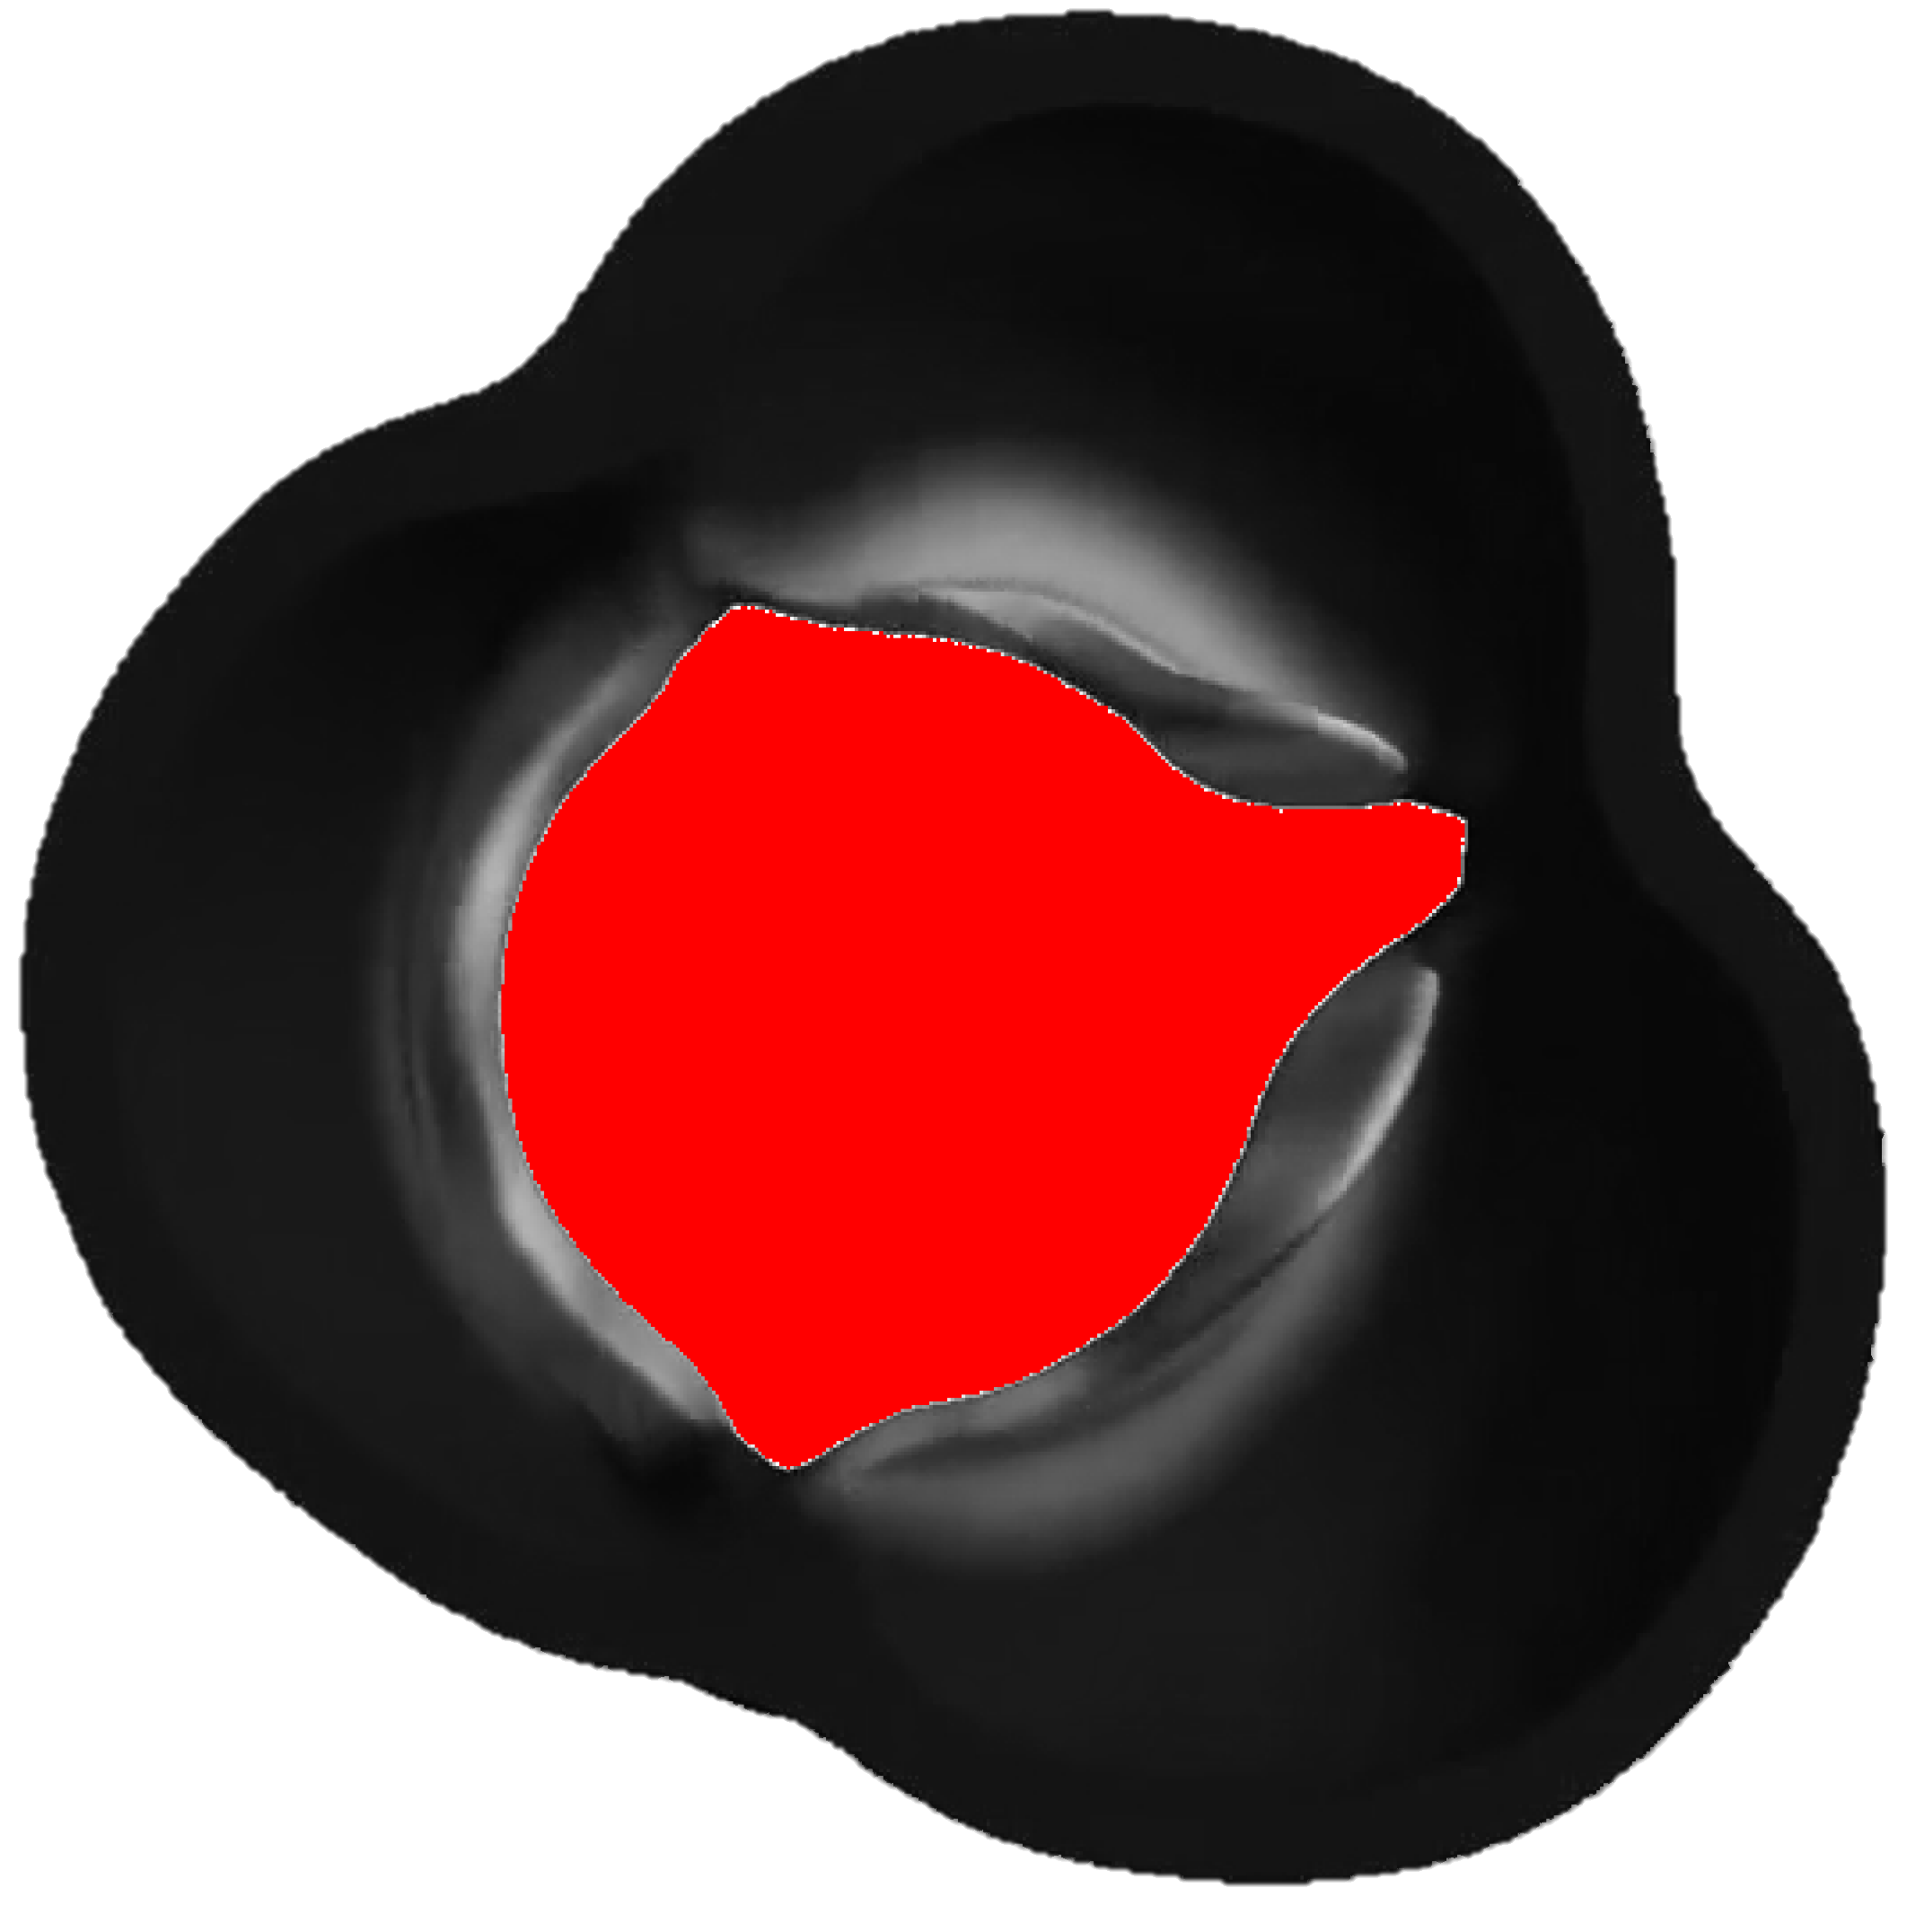
Summary Workflow
A
B
C
D
E
F
G
Figure 1. GOA Processing Steps A) Converting to grayscale B) CLAHE contrast enhancement C) Gaussian blurring D) Graph cut E) Flood fill F) Active contouring G) Mask region area calculation over time

Slide 12
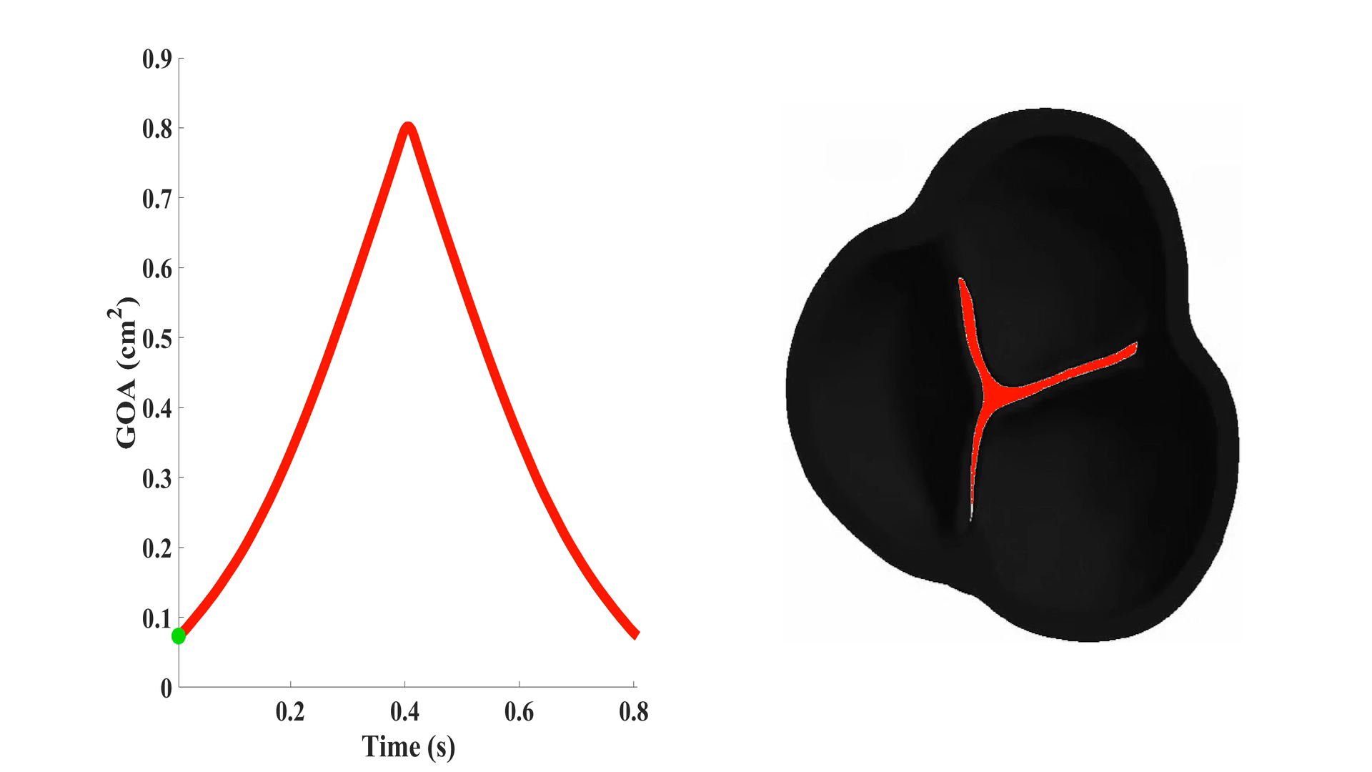
Results

Slide 13
Next Steps
Validate GOA with echo/CT derived values in literature.
Streamline code for optimization of image processing
Current ETA for 1 image: 2.5 seconds.
Current ETA for 1 video (~200 frames): 8.3 minutes

